Slide 1








Onboarding Funnel
Map the process of turning interest into confirmed membership.
Warm Welcome
Create a friendly introduction that makes new members feel valued and supported from the start.
Simple Guide
Offer step-by-step instructions that explain how to use the program effectively.
Early Value
Encourage members to experience one useful feature quickly to boost initial satisfaction.
Member Support
Provide easy help options such as quick tips or contact points to build confidence.
Program Tour
Introduce main sections of the program with clear explanations to reduce confusion.

Slide 2
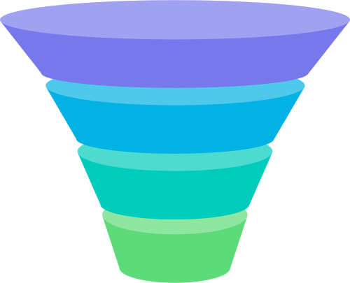



Advocacy Funnel
Describe how loyal members encourage others to join.
Story Share
Encourage members to share their positive experiences with peers and networks.
01
Referral Drive
Offer clear rewards or benefits for referring new members.
02
Social Proof
Showcase authentic testimonials and stories to attract others naturally.
03
Community Growth
Encourage members to bring in new participants, expanding the overall reach.
04

Slide 3


Initial Reach
Share program details through clear online and offline channels, making it easy for people to discover and show initial interest.
1
Audience Target
Identify potential members who match the program’s values and goals, focusing communication efforts on the groups most likely to participate.
2
Message Delivery
Use consistent, simple communication to explain what the program is, why it matters, and how it benefits new members.
3
First Interest
Track responses such as sign-ups, clicks, or questions to measure the success of the awareness stage and adjust communication if needed.
Awareness Funnel
4
Curiosity Build
Provide engaging entry-level content that encourages people to learn more and move forward in the funnel.
Outline the first stage where potential members learn
5

Slide 4










Consideration Funnel
Show the stage where potential members evaluate the program’s benefits.
Program Details
01
Present clear information about features, value, and structure so potential members can easily compare options.
Benefits Focus
02
Highlight simple, everyday advantages members will receive, helping them picture real outcomes of joining.
Trust Signals
03
Share transparent policies, FAQs, or testimonials to strengthen confidence in the program’s reliability and usefulness.
Decision Support
04
Provide easy tools or content like guides and comparisons to help individuals evaluate quickly.
Follow Engagement
05
Use follow-up communication to maintain contact and encourage steady interest without overwhelming the audience.

Slide 5



Signup Funnel
Map the process of turning interest into confirmed membership.
Provide an easy, simple registration form with only necessary fields to avoid drop-offs.
Confirm signups immediately with a welcoming message or email that reassures members of their successful registration.
Clear Form
Guided Steps
Show members the exact process for signing up, including clear instructions at every step.
Give new members immediate access to at least part of the program to deliver quick value.
Low Barriers
Confirmation Step
Minimize unnecessary obstacles, offering quick payment or free trial options to encourage faster signup.
Instant
Access

Slide 6
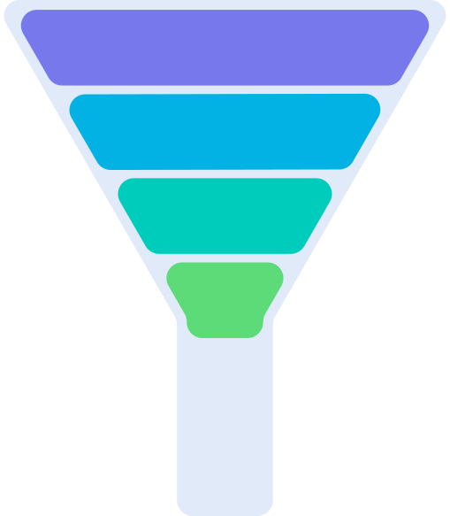
Engagement Funnel
Illustrate how members interact and remain active within the program.
Activity Drive
Promote participation in activities, rewards, or discussions to keep members involved.
Send clear updates and notifications to encourage consistent use of the program.
Regular Reminders
Feedback Loop
Gather and act on member input to improve features and maintain satisfaction.
Continuously highlight benefits and results to reinforce the importance of staying active.
Ongoing
Value

Slide 7


Retention Funnel
Show the steps that keep
members loyal over time.
Consistent Value
Member Care
Ensure the program delivers reliable and ongoing benefits that meet member expectations.
Address member questions and challenges quickly to reduce churn.
Reward System
Renewal Path
Recognize consistent participation with simple rewards that strengthen commitment.
Make renewal processes simple and predictable so members can continue without difficulty.

Slide 8





Loyalty Funnel
Highlight the stage where members feel deeply
01
Trust Build
Strengthen long-term trust by staying consistent and transparent in communication.
02
Community Role
Create spaces for members to connect and share experiences with each other.
03
Exclusive Access
Offer members unique features or perks not available to non-members.
04
Recognition Show
Publicly recognize and thank loyal members to deepen emotional connection.

Slide 9



Expansion Funnel
Show how members explore additional program options.
01
Upsell Options
Present optional upgrades that add extra value to their experience.
02
Cross Features
Introduce related features or activities that align with member interests.
03
Flex Choice
Offer flexible options that let members expand involvement based on preference.
04
Growth Track
Support members who want to progress further by showing clear next steps.

Slide 10



Renewal Funnel
Explain the simplified process of renewing or continuing membership.
Reminder Notice
Simple Process
Send timely reminders before renewal deadlines with clear instructions.
Future Value
Ensure renewing membership is quick and free of unnecessary steps.
Communicate upcoming benefits or updates to encourage continued commitment.

